Slide 1

Zomato Analytics

Slide 2
Index
Project Overview
Insights
Excel Dashboard Power BI Dashboard Tableau Dashboard SQL Conclusion

Slide 3

Project overview
Zomato Analytics
Objective: Analyze restaurant and customer data to uncover key insights.
Tools Used: SQL, Excel, Power BI / Tableau.
Key Analysis Areas: Average cost analysis, ratings & reviews, popularity & demand, restaurant density, service availability.
Outcomes: Identified top-performing categories and locations, highlighted customer preferences, suggested areas for expansion.
Dataset from Zomato (restaurants, ratings, locations, cuisines)
• Key fields: Restaurant Name, Location, Average Cost, Rating, Votes, Cuisine

Slide 4
Insights
Zomato analytics data
A Zomato data analysis project in Bengaluru showed that couples preferred restaurants with an average cost of ₹300 for two, indicating a preference for budget-friendly dining options.
The analysis might reveal that restaurants with online ordering options tend to receive higher ratings than those that don't.
A visualization might show the most popular cuisines in a specific area, allowing restaurants to optimize their offerings.
The analysis could also highlight the importance of location, suggesting that restaurants in certain areas may have a higher chance of success
Market Trends: Identifying the overall trends in the food delivery and restaurant industry.
Competitor Analysis: Analyzing the strategies and performance of Zomato's competitors.
SWOT Analysis: Assessing Zomato's strengths, weaknesses, opportunities, and threats.

Slide 5
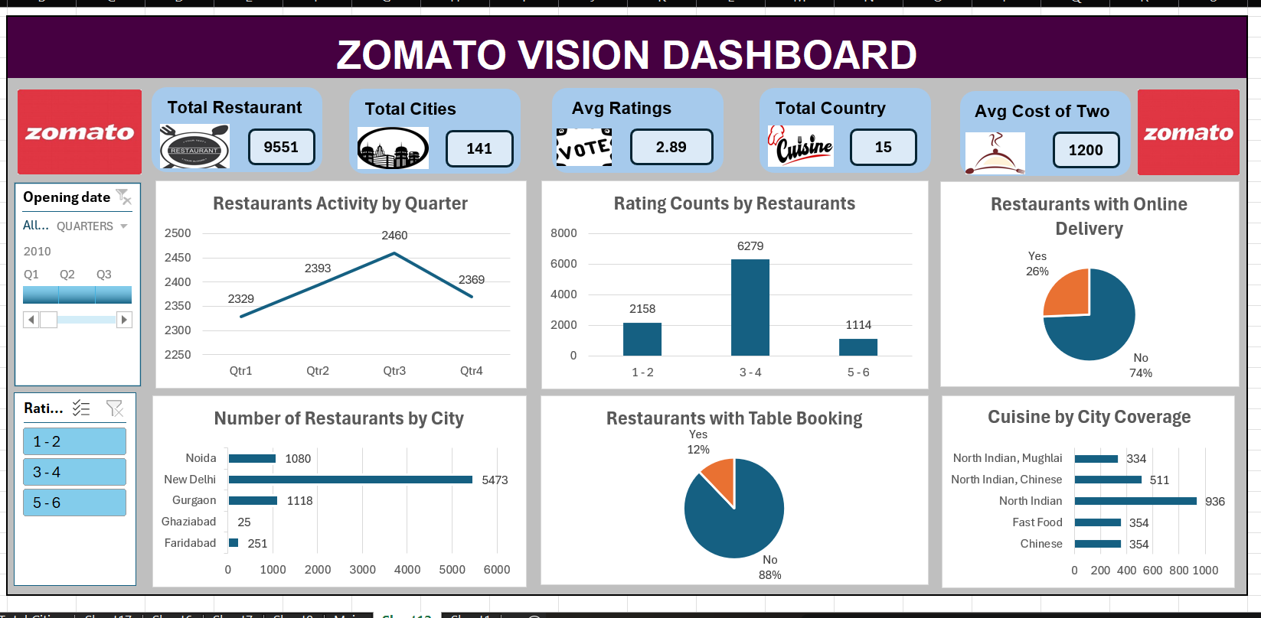

Excel Dashboard

Slide 6
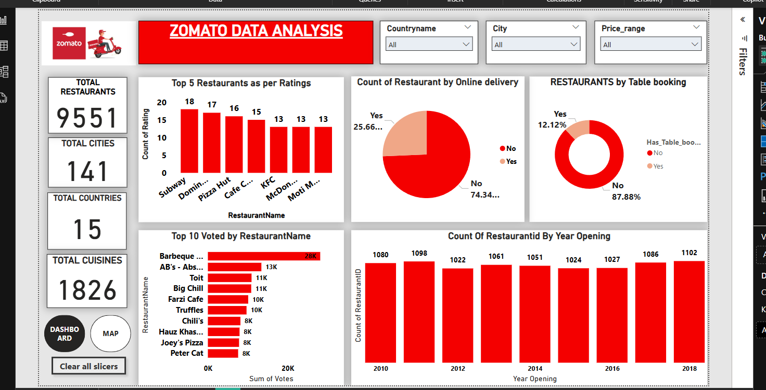

Power BI

Slide 7
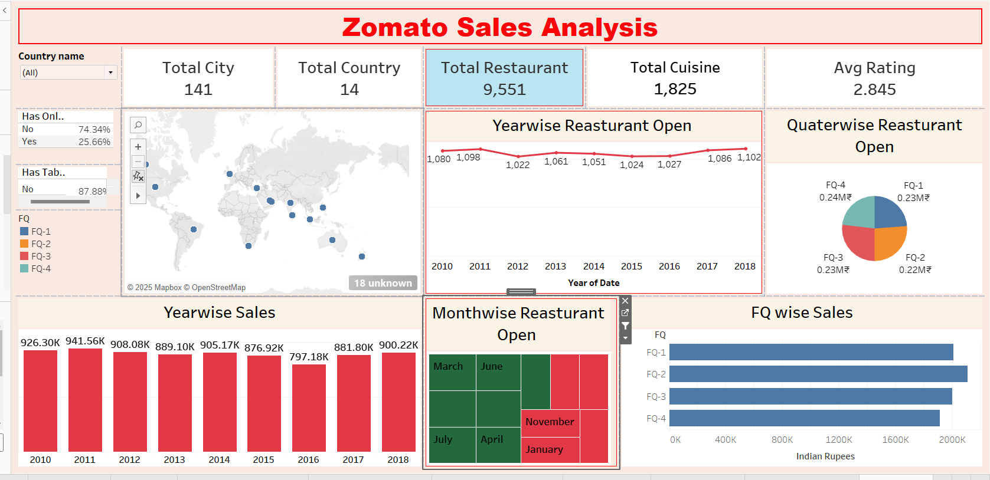

Tableau

Slide 8
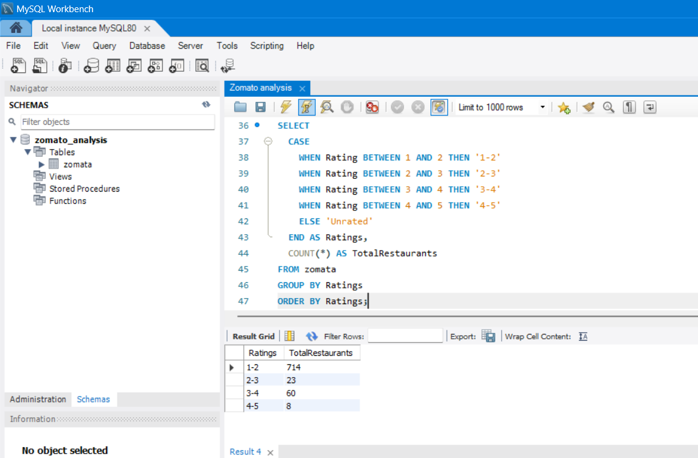
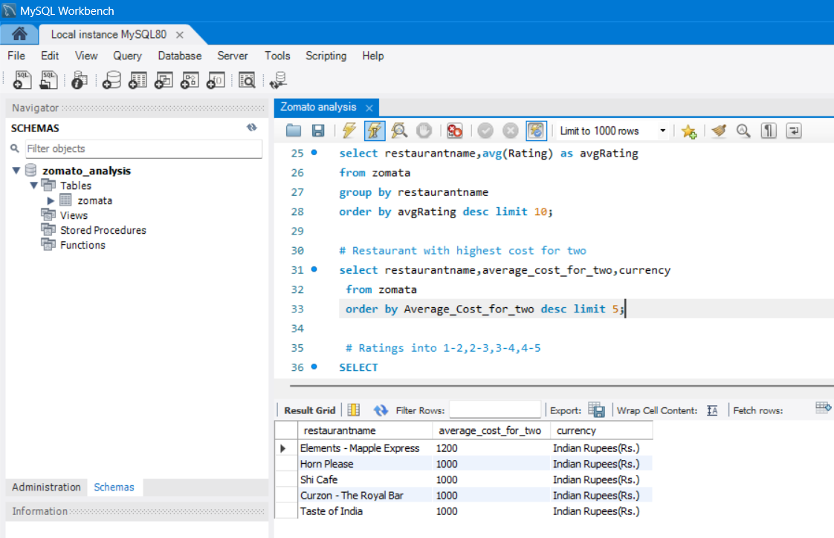
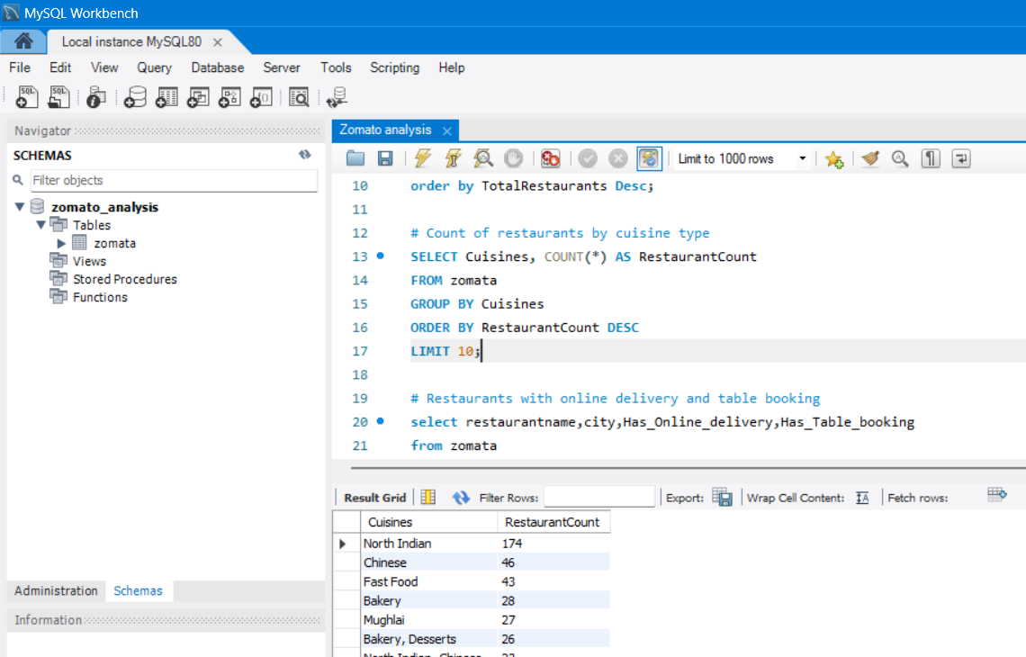
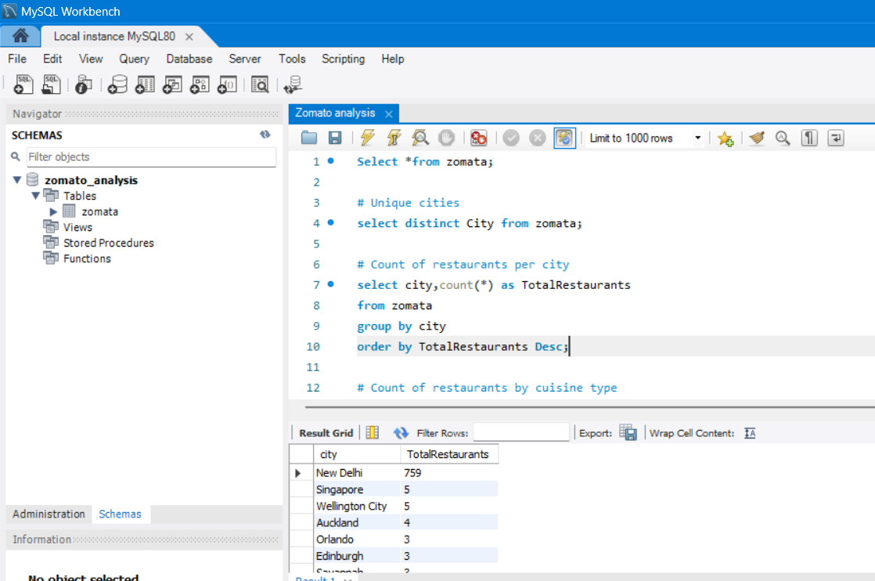

Slide 9
Conclusion
This project utilized Zomato data to extract meaningful insights into Order performance and customer transactions using Excel, SQL, Tableau, and Power BI.
Order Analysis revealed:
Zomato can personalize user experience through analytics.
Data-driven decisions reduce churn and boost engagement.
Restaurant Id Analysis showed:
A positive net cash flow (credit > debit) across branches.
Certain Restaurant and Restaurant id flagged for unusually high activity, suggesting risk.
The dashboards built allow real-time KPI tracking and support data-driven decisions.
Overall, the project highlights how analytics can enhance financial performance, mitigate risk, and improve operational focus.

Slide 10


